Slide 1
Presentation on
API for QR Code Based Merchant Payments
Prepared By:
Sreyans Singhi
Project Trainee
IIIT Bhubaneswar

Slide 2
API
API stands for Application Programming Interface. It helps a user’s product or service to communicate with other product or service like dynamically posting content from one application to another, extracting data from a database in a more systematic way than a regular UI might allow. Basically it is a part of the server that receives requests and sends responses.

Slide 3
WORKING
Example :
When we use an application on our mobile phone, the application connects to the Internet and sends data to the server. The server then retrieves that data, interprets it and sends it back to our phone. The application then interprets that data and presents us with the information we wanted in a readable way. This is what an API is - all of this happens via API.

Slide 4
TYPES OF APIs:
1.WebAPIs
A Web API also called as Web Services is an extensively used API and can be easily accessed using the HTTP protocols. It is an open source interface and can used by large number of clients through their phones, tablets or PCs.
2. Local APIs
In this type of APIs the programmer get the local middleware services.
TAPI(Telephony Application Programming Interface), .NET are
common example of Local APIs.
3.Program APIs
It makes a remote program appear to be local by making use of
RPC’s(Remote Procedural Calls)

Slide 5
FORMAT:
XML:
XML stands for eXtensible markup language. It is a software and hardware- independent tool for storing and transporting the data. It is a markup language much like HTML. It defines a set of rules for encoding documents in a format that is both machine readable and human readable. It doesn’t have predefined tags just like HTML.
-
JSON:
JSON stands for JavaScript Object Notation. It is a lightweight data-interchange format and is completely language independent. It is based on JavaScript Programming language. It is often used when data is sent from a server to web page.

Slide 6
JSON XML
{"employees":[ <employees>
{ "firstName":"John", "lastName":"Doe" }, <employee>
{ "firstName":"Anna", "lastName":"Smith" }, <firstname>John</firstname>
]} <lastname>Doe</lastname>
</employee>
<employee>
<firstname>Anna</firstname>
<lastname>Smith</lastname>
</employee>
</employees>

Slide 7
DIFFERENT MODES OF PAYMENTS
1. IMPS(Immediate Payment Service)
2. NEFT(National Electronic Funds Transfer)
3. UPI(Unified Payments Interface)
4.AePS(Aadhar Enabled Payment System)

Slide 8
IMPS
IMPS provides robust and real time fund transfer which offers an instant, 24*7, interbank electronic fund transfer service that could be accessed on multiple channels like Mobile, Internet, ATM, SMS, Branch and USSD(*99#). It allows the transfer of funds across banks in the country in a safe and economical way.
FUND TRANSFER:
1. Using Mobile Number and MMID
2. Using Account Number and IFSC Code
3. Using Aadhaar Number

Slide 9
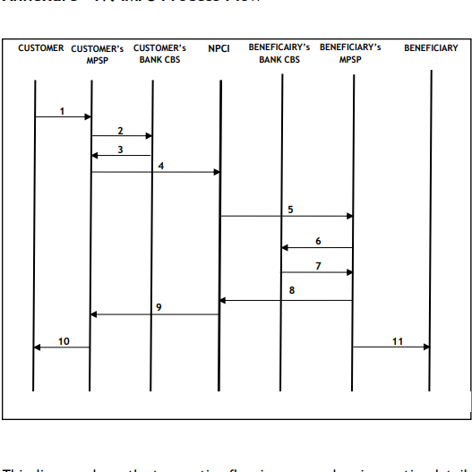

Slide 10
UPI
UPI stands for Unified Payment Interface. It is a system that combines multiple bank accounts into a single mobile application, merging several banking features, seamless fund routing and merchant payments into one hood.
FEATURES:
Immediate money transfer round the clock 24*7 and 365 days.
Single Mobile Application for accessing different bank accounts.
Merchant Payment with single application or in-app payments.
Removes cash on delivery hassle, running to an ATM or rendering exact amount.

Slide 11
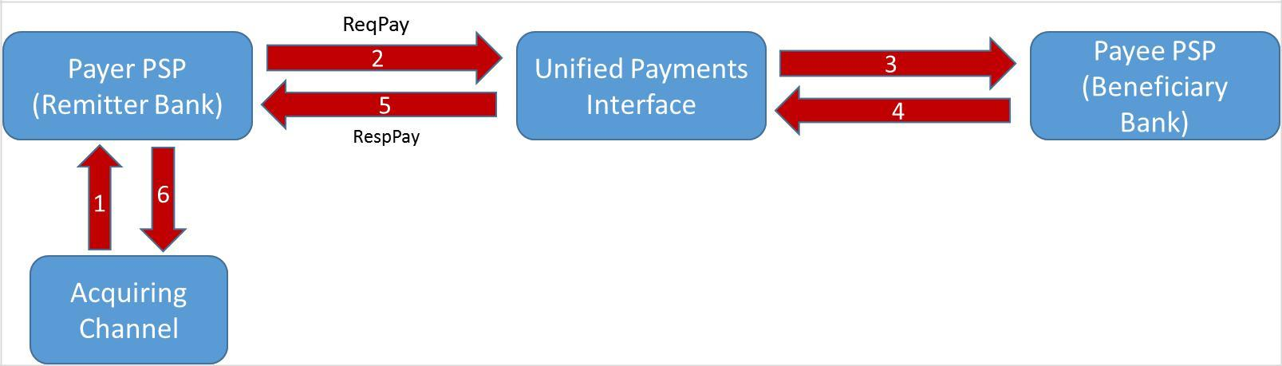

Slide 12
NEFT
NEFT stand for national electronic funds transfer. It is a nation wide payment system facilitating one to one funds transfer. Under this payment system individuals, firms and corporates can electronically transfer funds from any bank branch to any individual, firm or corporate having an account with any other bank branch in the country.
Requirements for Transaction:
Name of the beneficiary and the name of the bank branch where he has an account.
IFSC code of the beneficiary bank branch.
Account Type
Account Number

Slide 13
AePS
AePS stands for Aadhaar Enabled Payment System. It is a bank led model which allows online interoperable financial inclusion transaction at PoS(Micro ATM) through the business correspondent of any bank using the aadhaar authentication. The only inputs required for a customer to do a transaction under this scenario are:
IIN(Identifying the bank to which the customer is associated)
Aadhaar Number
Fingerprint captured during their enrollment

Slide 14
QR Code
QR Code stands for Quick Response Code which refers to instant access to the information hidden in the code. It is two dimensional version of the barcode. Originally developed for process optimization in the logistics of automotive industry, the QR Code has found its way into mobile marketing with the widespread adoption of the smartphones.
Advantages:
Versatility
Saves time
Chances of entering wrong data for transaction is nil

Slide 15


How is a QR Code Structured?
Positioning Markings
They indicate the direction in which code is printed.
Alignment Markings
If the QR Code is large this additional element helps with
orientation.

Slide 16


Timing Pattern
Using these lines, the scanner determines how large the data
matrix is.
Version Information
This specify the version of QR Code that is being used.
There are about 40 versions of QR Code.

Slide 17



Format Information
The format pattern contains information about the error tolerance
and the data mask pattern and makes easier to scan the code.
Data and Error Correction Keys
These pattern hold the actual data.
Quiet Zone
This spacing is important for the scanning program in order to
distinguish the QR Code from its surroundings.

Slide 18
Thank You

